Slide 1

Household Anxiety and Depression Likelihood Prediction
by Coco Yang

Slide 2
CONTENTS
01.
Project Overview
02.
Feature Engineering
03.
Modeling
04.
Next Action

Slide 3

Project Overview
PART 01

Slide 4
Project Overview
The project's primary focus lies within the healthcare sector, specifically addressing mental health concerns. Recent trends indicate a rising prevalence of anxiety and depression, with a substantial portion of affected individuals often unaware of their condition or its significance. This issue has been exacerbated by the COVID-19 pandemic, widespread unemployment, and economic uncertainties. Furthermore, individuals within households can influence each other's mental well-being.

Slide 5

PART 02
Relabel Target Columns
Encoding
Feature Engineering
Colinearity & Multilinearity

Slide 6
Get the target column of Major Depression Disorder
No Target Column
Independent Columns: INTEREST + DOWN
Values: not at all (1), several days(2), more than half the days(3), nearly every day(4)
Binary Target Column
INTERET + DOWN
>=5, Major Depression (Yes)
<5, Not Diagnosed as Major Depression (No)
Multi-class Target Column
>=5: Major Depression Disorder
>2,<5: Mild Depession
=2: No Depression

Slide 7
Get the target column of Generalized Anxiety Disorder
No Target Column
Independent Columns: ANXIOUS + WORRY
Values: not at all (1), several days(2), more than half the days(3), nearly every day(4)
Binary Target Column
ANXIOUS +WORRY
>=5, Generalized Anxiery Disorder(Yes)
<5, Not Diagnosed (No)
Multi-class Target Column
>=5: Generalized Anxiety Disorder
>2,<5: Mild Anxiety
=2: No Anxiety

Slide 8
Encoding
Label Encoding
Target Columns
1
2
3
Oridinal Encoding
Income,
Education,
etc
1,2,3,4,5,6
One-hot Encoding
Binary Variable,
Nominal Vairables
1 and 0;
Dummies

Slide 9
Encoding
Data Preprocessing
Data Validation
Handling Missing Values
Data Visualization
Exploratory Data Analaysis (EDA)
Dashboard Creation
Feature Engineering
Feature Selection
Encoding

Slide 10
Modeling & Evaluation - Target Column: Depression
PART 03

Slide 11
Multinomial Logistic Regression
Baseline Model : 68.76%
Model after Scaled: 71.07%
Model after Scaled & PCA: 60.8%
Model after Scaled and Hyparameter Tunning : 71.25%

Slide 12
Random Forest
Baseline Model : 70.35%
Model after Hyparameter Tunning : 71.67%

Slide 13
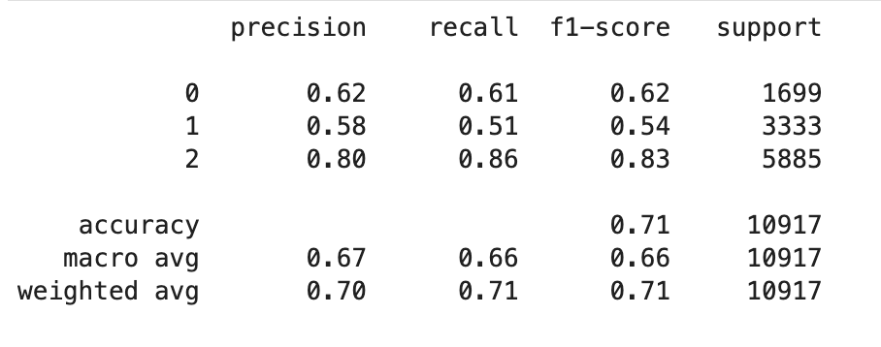
Model Evaluation
Cverall accuracy : 71%
Class 2 : high precision, recall, and F1-score values
Class 0 & 1 : relatively low
Future Focus: addressing the imbalances

Slide 14
Next Action
PART 04

Slide 15
Modeling
Optimization
Deployment

Slide 16
Thank you

